Slide 1

UDDHARAK:
Temperature and Humidity
Monitoring System
Team: Rookie Impostors
Member: Vaibhav Sharma

Slide 2

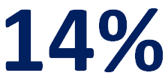
Problem Statement
(WHAT we are trying to solve)
According to FAO, produce worth a staggering $14 billion is damaged annually due to wastage during storage.
If a reliable solution to this food storage problem is not found out soon, this problem will grow exponentially and will reach a critical stage.
200 million or about 14 in every 100 persons in India are malnourished
*FAO - Food and Agriculture Organization
It is evident from this graph that we are self sufficient in terms of production of food grains
Since, we produce more than enough grains for our requirements, then why is it that such a large section of our population is malnourished?

Slide 3
Problem Statement
(WHAT we are trying to solve)
Distribution of Storage Method of Grains
Today, large amounts of crop wastage can be attributed to inefficient traditional storage methods.
We believe that we can use the funds saved by preventing the grains from being spoiled can be routed to provide incentives in order to help farmers migrate from traditional waste-prone methods to modern waste-averse methods, which will further reduce the wastage of food grains.
The Real Problem
Currently there is a glaring delay between the point of time when the stored grains start to rot (due to any factor) and the point of time when the person managing the storage medium gets to know about it and takes action to mitigate the damage.
It is this delay which we aim to minimise (and possibly mitigate the loss as well) which will help take the measures sooner and cut the losses.

Slide 4
Problem Statement
(WHAT we are trying to solve)
Methods of Storage
Small-Scale Grain Storage Structures
Storage Container | Associated pest control methods
Bagged or small container storage
Sealed pots, gourds etc. | Self-disinfesting, if sufficient airtight
Conventional Bags | Mixing a grain protectant.
Small-scale bulk storage
PUSA Bin | Capacity: 1 to 3 tones Advantage: easy to install
Underground Pits | Can keep grain without damage for many years. Advantage: Useful in Adverse weather
Domestic Hapur Bin | Capacity: 200 to 1000kg Cost: Rs350 to Rs1200 Advantage: Portable and easy fabrication
Coal Tar Drum Bin | Capacity: 150 kg Cost: Rs 682 Advantage: Useful in Humid Location, Cheaper than metal container

Slide 5
Ideal Storage Conditions
40
30
20
10
0
Suitable condition for insect growth
Temperature (ºC)
Fall in Germination
Suitable condition for fungal growth
10 15 20 25
Moisture (%)
Hence, we can see that only the white area provides the ideal storage conditions for grains

Slide 6
Ideal Storage Conditions
Relative Humidity (%)
Temperature (°C)
*For most cereals, it will increase by approximately 0.5 percent for every 10 °C temperature fall at the same percentage relative humidity of the air.
After research we found that Wheat, Rice and Maize are the grains which are majorly stored using traditional and modern methods of storage. Hence, we compare them in terms of moisture content and temperature and humidity limits.

Slide 7
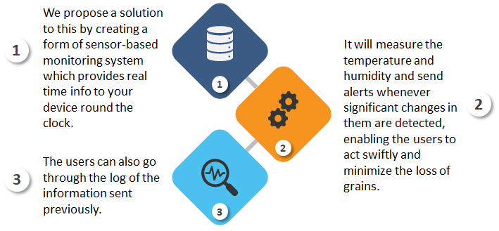
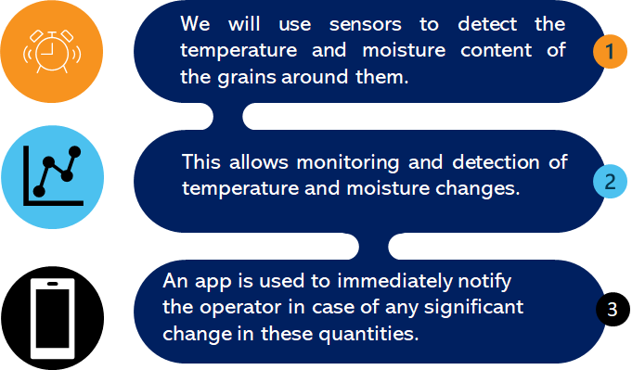
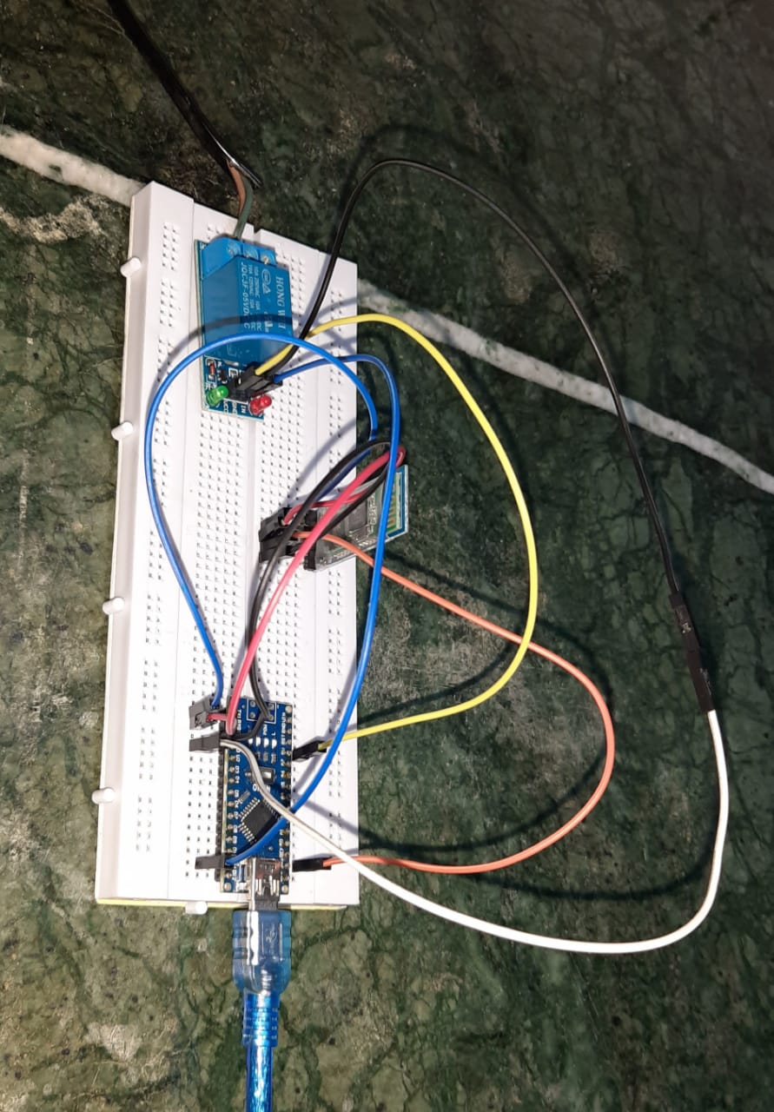
The Proposed Solution
Automation Measures
(HOW we are trying to solve the problem)
We also plan to introduce automation in our product which will allow it to take mitigative measures in addition to sending the alert to the user.
This has been implemented and tested using a Relay which is connected to an Arduino Nano and which will be used to power appliances such as Exhaust Fans.
When the Sensors detect the changes, they will automatically switch the appliance ON in addition to sending the alert which will further help mitigate the damage and cut losses.
Communications Module
(Bluetooth)
Relay
Arduino Nano
Process of Detection
Wire for powering the Appliance

Slide 8
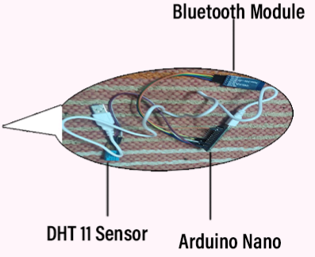
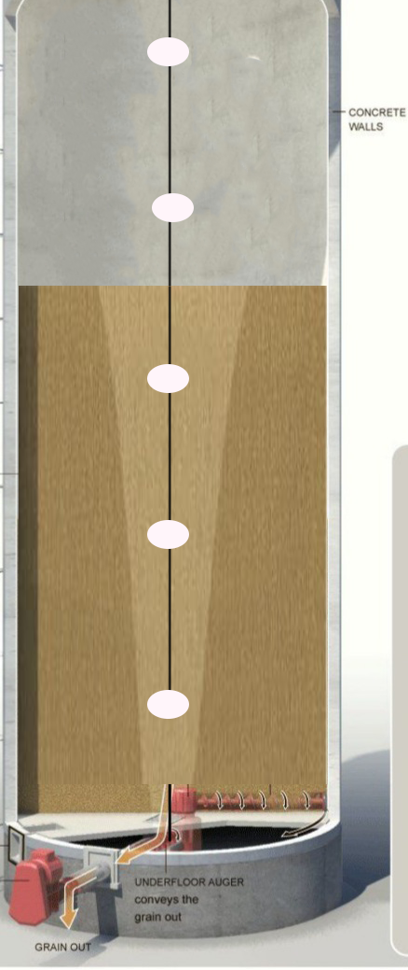
The Proposed Solution
(HOW we are trying to solve the problem)
Sensors, Communications Unit and Microcontroller inside the Spherical Casing
The diagram has been shown for a Storage Container and the sensors will be implemented in a similar manner for other methods of Storage as well.

Slide 9
Estimated Manufacturing Cost
(WHAT it would take to solve the problem)
₹1000
₹350
₹350
₹200
DHT-11 sensor
Arduino Nano
Communications module
Miscellaneous
After reasonably overestimating and adding up the costs of all our components, we expect our Total Cost to be around ₹ 2000 which is extremely cost effective as compared to the current competitors.
Notes:
© Copyright PresentationGO.com – The free PowerPoint and Google Slides template library

Slide 10

Sales / Revenue Model
(WHAT it would take to solve the problem)
Who Pays?
Small Size Farmers
Medium Size Farmers
Target Market Segment
(for WHOM we are trying to solve the problem)
What services are provided?
Product
Maintenance
How is it paid?
Credit
Subscription
How much is paid?
₹ 2000

Slide 11
Three Year Plan for the Product
(Plans and Projections)
Stage 1
Stage 2
We plan to initially create the testing units and related components domestically using In House manufacturing with the help of the Prize Money.
We also plan to approach the government for funds in order to expand our product’s reach.
Concurrently we will keep a record of the market's reaction towards our product and act accordingly to establish our manufacturing units in Tier 2 cities as well.
This will be done in order to maintain the balance between manufacturing and transportation cost
(Required Government Support)
Stage 3
Stage 4
Stage 5
We will initially provide our product to grain producing high income states like Punjab, Haryana, Madhya Pradesh etc.
As we stabilize our profit with our expenditure, we can further expand it to other states like Bihar, Jharkhand etc.
Three years down the lane, we will automate our production units and improve upon our product using the data collected from our units.
We will also implement AI/ML models for additional features and more accurate results.
While adding newer features will be our focus, our main objective will still be to provide low cost solutions to farmers.
Notes:
© Copyright PresentationGO.com – The free PowerPoint and Google Slides template library

Slide 12
Go-To Market Strategy
(Plans and Projections)
(Required Government Support)
Our plan is to seek Government Support for endorsing our product.
We will use the prize money for Beta Testing of our products with the target demographic being the farmers in different regions.
We will also collect data from these products.
01
02
We believe that the a big hurdle for our product’s commercial success will be to gain the required customer base.
Hence, we plan to invest 40% of our funds in manufacturing and the rest of the 60% in marketing.
We also plan to collaborate with a number of AgriTech startups and also sell our product online on Agricultural Markets.
We plan to increase our sales by hiring villagers on a commission per sale basis too.
04
03
We will reach out to the customers via advertising on various mediums such as on television, in Newspapers, Posters, Gram Panchayats
We also plan to advertise on farmer's equipment shops.
Notes:
© Copyright PresentationGO.com – The free PowerPoint and Google Slides template library

Slide 13
Competitive Analysis
Company Name | Multiple Manufacturers like Adwin, Delphin, Grant | Bridge
Features | Temperature and Humidity monitoring sensors with data available on mobile app | Data Logger, Humidity and Temperature sensors
Cost | ₹ 15000 (approx.) | ₹ 18000 (approx.)
There aren’t many competitors in this section of the market and even the existing ones target the advanced methods of storage such as Silos, with no such technology for the other methods. Also, their cost is very high when compared to the utility and service they offer.
Our product is extremely cost effective since it costs about 7 to 8 times lesser than what the existing products cost.
Also, our product targets the alternate and cheaper methods of storage which will help the Small and Medium farmers of our country since most of them cannot afford to use the costly methods such as Silos.

Slide 14
Benefits and Advantages
(Impact)
Food Grain Wastage
(Environmental Impact)
Economy
(Economic Impact)
Lesser food grain waste produced.
Reduction in losses due to food grain wastage, thus the funds saved can be diverted elsewhere.
Hunger (Social Impact)
Human Error
Alleviation of our country’s food shortage problem.
Contributes to circular economy as well.
Elimination of human error due to automation measures taken.
Notes:
© Copyright PresentationGO.com – The free PowerPoint and Google Slides template library

Slide 15
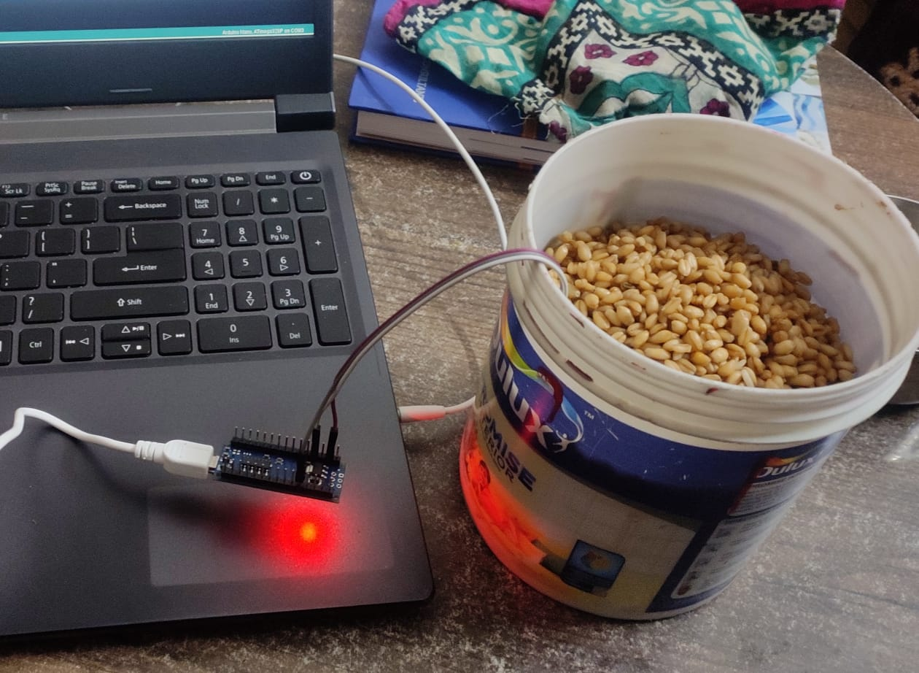
Prototype Testing
(in Dry Conditions)

Slide 16
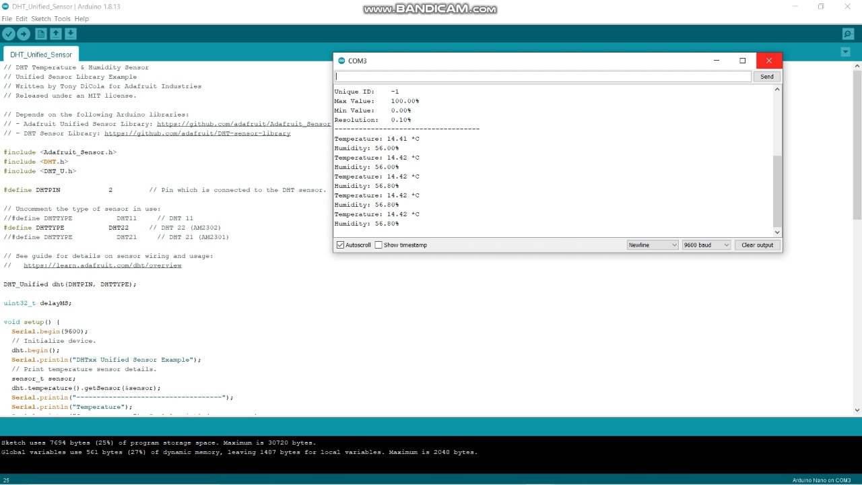
Prototype Testing
(in Dry Conditions)
Code Snippet
Temperature: 14.42 °C
Humidity: 56.8%
Serial Monitor showing output

Slide 17
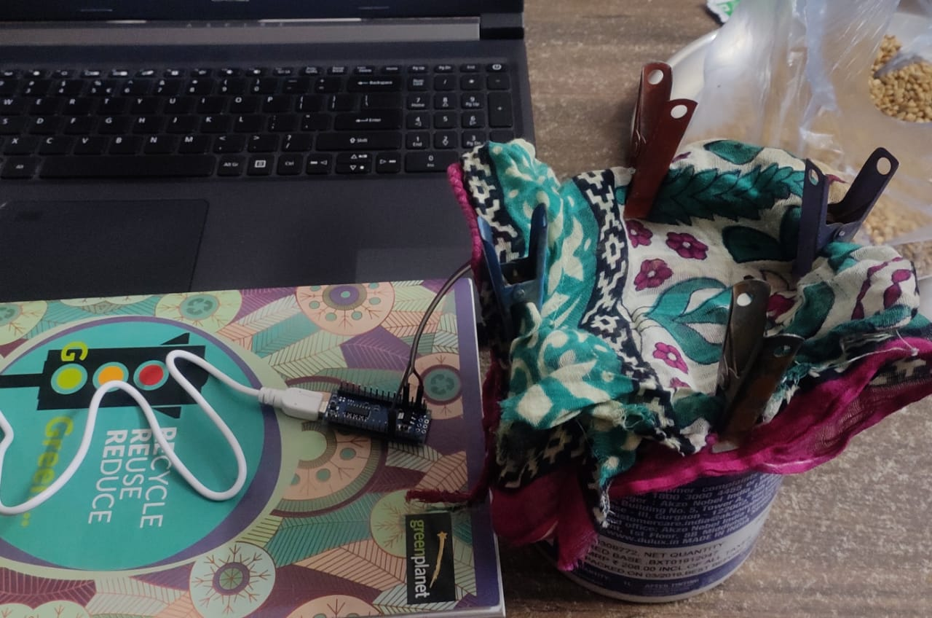
Prototype Testing
(in Humid Conditions)

Slide 18
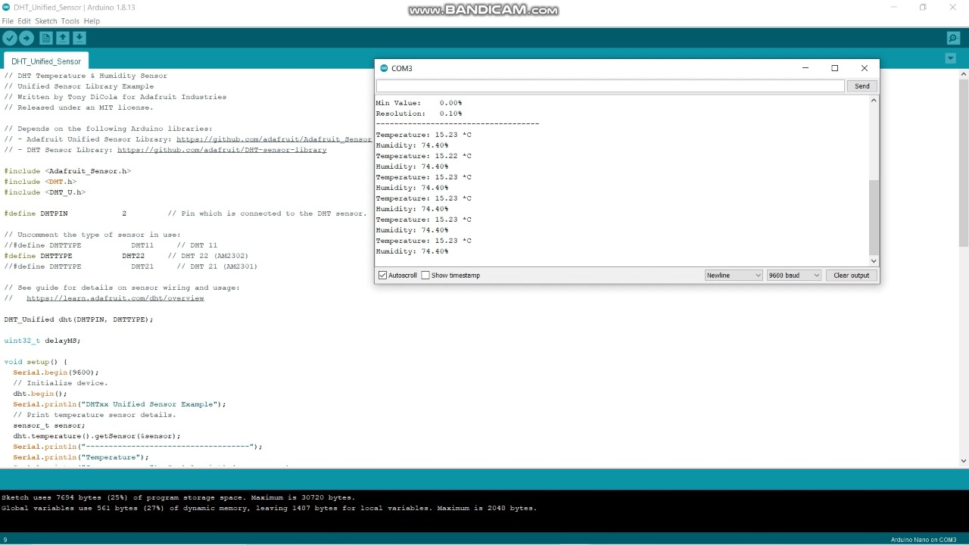
Prototype Testing
(in Humid Conditions)
Code Snippet
Temperature: 15.23 °C
Humidity: 74.4%
Serial Monitor showing output

Slide 19
Further Improvements
Diversify
Accuracy
Cost
Addition of new features for Prediction
Diversify the produce with which our product can work.
Improve accuracy of our product by further working on the technology.
Consistently work towards lowering cost, so that our product can be used by a larger demographic.
Working towards incorporating AI/ML models in our product which rely on the monitored data in order to predict whether the grains will rot or not.
Notes:
© Copyright PresentationGO.com – The free PowerPoint and Google Slides template library

Slide 20
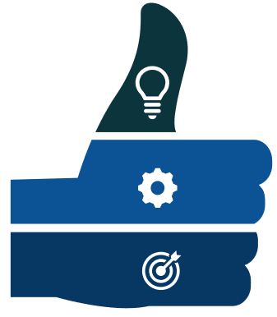
Further Improvements
Our product is a frugal innovation and mainly aims to help the Small and Medium scale farmers.
We aim to incorporate AI/ML models in our product which rely on the monitored data and to include a number of features for automation such as using bulbs and exhaust fans.
Hence, today we are able to detect but tomorrow we will be able to predict the rotting or spoiling of crops.
Notes:
© Copyright PresentationGO.com – The free PowerPoint and Google Slides template library

Slide 21


